Slide 1
Flexible Cache Simulator
Lakshmi Katravulapalli
COP 5611

Slide 2
Introduction
Cache = small, fast memory that stores frequently accessed data to speed up future access
Project focuses on Computer Architecture and Memory Systems
Inspired by prior Computer Architecture coursework and interest in memory access patterns
Explores the impact of cache configurations on performance (size, associativity, replacement policy)
Goals:
Build a flexible cache simulator in C++ with configurable options
Simulates and compares results across random and sequential trace files
Learn how design decisions affect hit rate, miss types, and overall cache performance

Slide 3
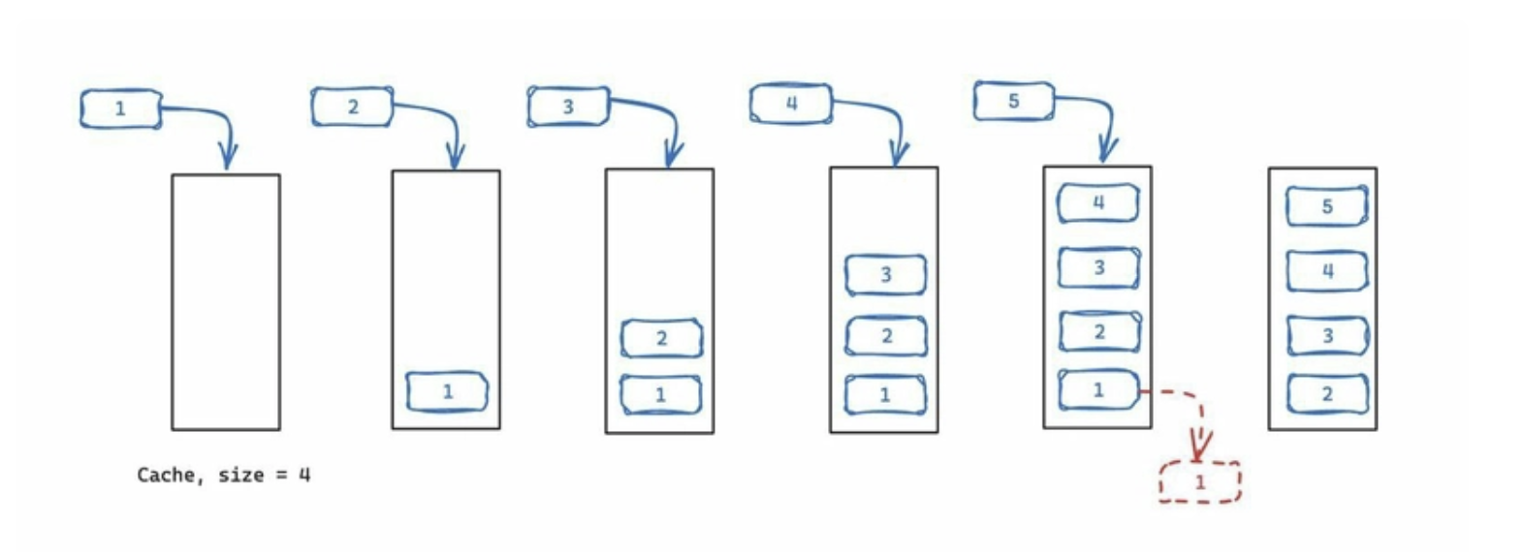
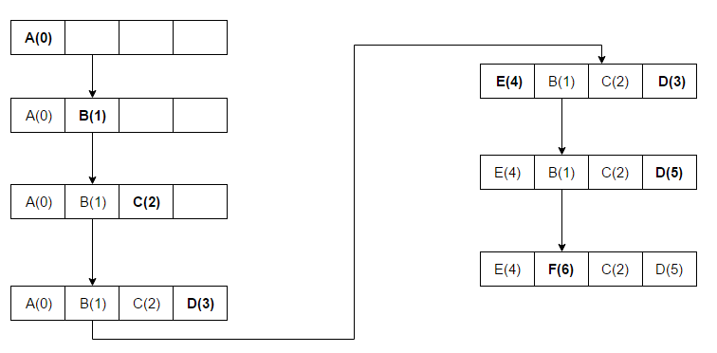
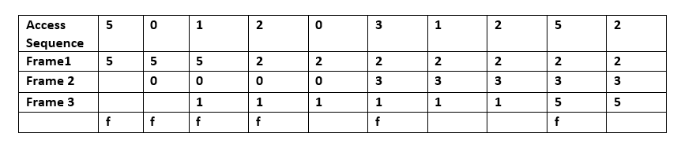
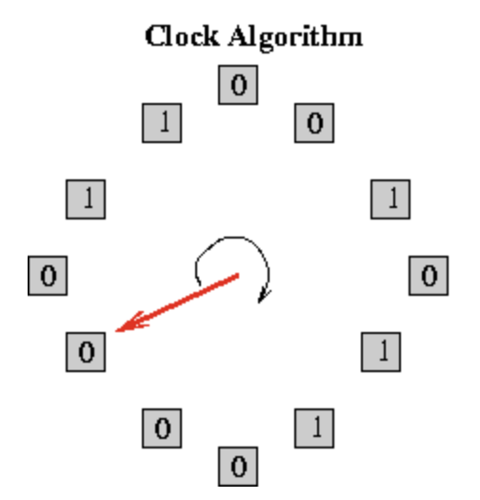
Replacement algorithms
FIFO (First-In, First-Out): Replaces the oldest block that was loaded into the cache.
LRU (Least Recently Used): Replaces the block that hasn’t been accessed for the longest time.
Optimal (Belady’s Algorithm): Replaces the block that will not be used again for the longest time in the future.
Clock (1-Bit): Approximates LRU using a reference bit and circular buffer to give blocks a second chance.
Clock (2-Bit): Enhances 1-bit Clock by using two reference bits to better track recent usage.
LIFO (Last-In, First-Out): Replaces the most recently added block.

Slide 4
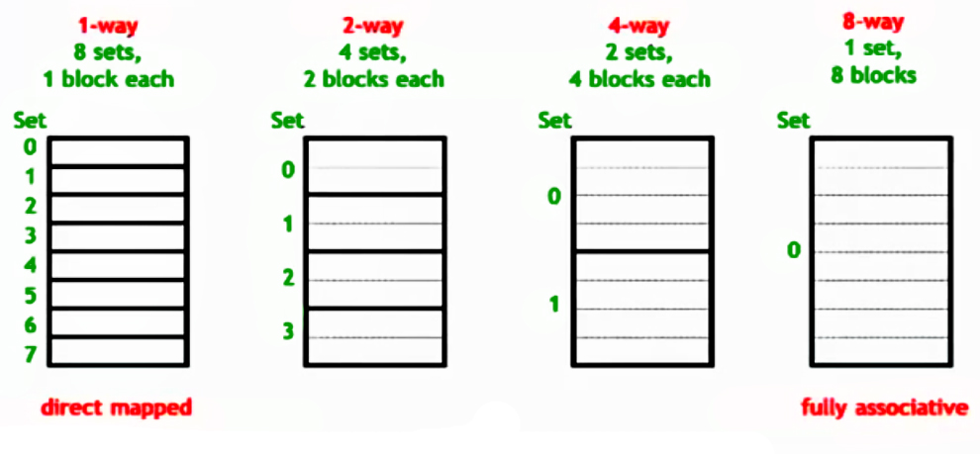
Cache Associativity
Direct-Mapped: Each memory block maps to exactly one cache line, simple but prone to conflicts.
2-Way Set-Associative: Each block can go into one of two lines in a set, reducing conflict misses.
4-Way Set-Associative: Allows a block to be placed in one of four lines per set, offering more flexibility.
Fully-Associative: Any block can go into any line, minimizing conflict misses but increasing complexity.

Slide 5
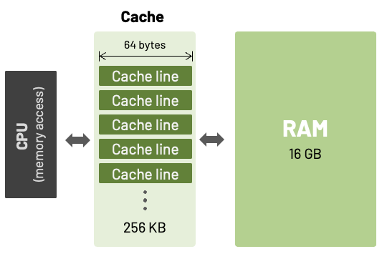
Cache Size
The total amount of data a cache can store, typically measured in bytes.
Cache Sizes (Constant 8 Block Cache)
512B: 8 blocks × 64B/block = 512 bytes
1024B: 8 blocks × 128B/block = 1024 bytes
2048B: 8 blocks × 256B/block = 2048 bytes
4096B: 8 blocks × 512B/block = 4096 bytes

Slide 6
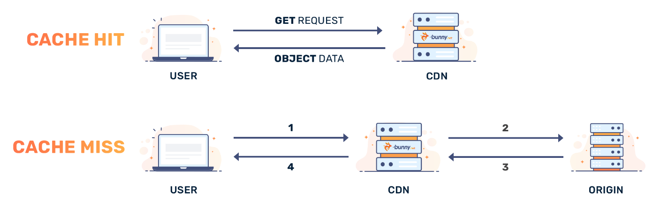
Hit Rate/Miss Rate (Different types of Misses)
Hit Rate: Percentage of memory accesses found in the cache Hit Rate = (Total Hits / Total Accesses) * 100
Miss Rate: Percentage of memory accesses not found in the cache Miss Rate = (Total Misses / Total Accesses) * 100
Types of Cache Misses:
Compulsory Miss: First time a block is accessed (cold start)
Capacity Miss: Cache is too small to hold all required blocks
Conflict Miss: Multiple blocks map to the same cache line/set

Slide 7
Methodology
System Design Focus:
Models real-world CPU cache interactions
Demonstrates effects of hardware configurations on performance
Enhances understanding of memory hierarchy
Development Tools:
Language: C++
IDE: Visual Studio Code
Platform: Ubuntu WSL
Trace Files:
Types: Random and Sequential
500 memory accesses each
Used higher count for more accurate results
Created separate files for different operations
Used standard libraries such as stdio.h, stdlib.h, and string
Test Run Input:
./cache-sim-os <trace-file> <associativity> <cache-size> <replacement-algorithm-#> [-t]
(-t is an additional feature shows the tag for every memory access and the image of the set)

Slide 8
Results
Direct-Mapped Cache – Random Trace Results (1024B Cache Size)
Trace File: Randomized, 500 memory accesses (reads/writes)
Configuration: Direct-mapped associativity with various replacement policies
Cache Size Used: 1024 Bytes
Observed Results:
Hit Rate: 71%
Miss Rate: 28%
Results remained constant across all replacement policies
Reason:
Direct-mapped caches map each block to a single, fixed location
No flexibility in replacement – only one possible location
Replacement policies have no effect due to lack of block choice
8 block cache, Direct-Mapped, 1024 Cache Size

Slide 9
8 block cache, 2-Way, 1024 Cache Size
2-Way Associative Cache – Random Trace Results (1024B Cache Size)
General Improvement in Hit Rate compared to direct-mapped
FIFO: 72% – evicts oldest block, ignores usage frequency
LRU: 74% – keeps recently used blocks, more efficient
Optimal (Belady’s): 78% – predicts future access, best theoretical performance
Clock (1-bit): 72% – approximates LRU, evicts too quickly
Clock (2-bit): 73% – retains blocks longer, better than 1-bit
LIFO: 71% – removes most recently added block, ignores access patterns
8 block cache, 4-Way, 1024 Cache Size
4-Way Associative Cache – Random Trace Results
Same trend as 2-way, higher hit rates overall
FIFO: 75%
LRU: 75%
Optimal: 81%
Clock (1-bit): 76%
Clock (2-bit): 77%
LIFO: 69%

Slide 10
8 block cache, Fully Associative, 1024 Cache Size
Fully-Associative Cache – Random Trace Results
Most flexibility, best chance to optimize replacements
FIFO: 76%
LRU: 79%
Optimal: 82% – highest hit rate overall
Clock (1-bit): 77%
Clock (2-bit): 79%
LIFO: 59% – lowest hit rate, performs poorly
Increased Associativity = Higher Hit Rate
Direct-mapped caches cause more conflict misses due to strict block-to-set mapping
2-way, 4-way, and fully-associative caches provide more placement flexibility, reducing evictions
Fully-associative cache had the highest hit rates due to least restrictions
Cache Miss Types Observed
Compulsory (Cold) Misses: 8 – due to first-time block accesses
Conflict Misses: 3–16 – reduced with higher associativity
Capacity Misses: Most common – cache too small (only 8 blocks) to hold active working set
Main Cause: Cache can't retain reused blocks due to limited space, causing frequent evictions

Slide 11
Continuation of Results
Sequential Trace File Results
Consistent Results Across Policies & Associativities
~50% hit/miss rate regardless of replacement policy or associativity
No conflict misses observed due to ordered memory access
Most misses were capacity misses – cache too small for large sequential access
Reason: Predictable Access Patterns
Sequential traces follow a linear and deterministic memory access order
Cache policies had little impact because all followed the same pattern
Exhibited Locality Principles
Spatial Locality: Access to one address often followed by neighboring addresses
Temporal Locality: Recently accessed memory likely to be accessed again soon
Main Insight:
Cache behavior is strongly influenced by the nature of memory access patterns, not just cache configuration

Slide 12
Results – Cache Size Comparison
8 block cache, 2-way, 512 Cache Size
8 block cache, 2-way, 1024 Cache Size
8 block cache, 2-way, 2048 Cache Size
8 block cache, 2-way, 4096 Cache Size

Slide 13
Cache Size Comparison – Randomized & Sequential Trace Files
Cache Sizes Tested: 512B, 1024B, 2048B, 4096B (with 8-block cache)
Cache size calculated as: Block Size × Number of Blocks
Key Observation:
Hit rate consistently increased as cache size increased for both trace files
Types of Misses Observed:
Majority were capacity misses, especially in smaller cache sizes
Fewer misses as cache size increased, confirming space limitation was a key factor
Random Trace with Optimal Policy:
512B → 74% hit rate
1024B → 78%
2048B → 83%
4096B → 85%
Reason:
Larger caches store more data, reducing the chance of eviction
Increases the likelihood that frequently accessed data stays in cache
Confirmed Trend Across Both Trace Types:
Random and Sequential traces both showed improved hit rates with larger cache sizes
Even with consistent replacement policy behavior, size had major impact
Optimal Policy Performance:
Consistently achieved the highest hit rate in all configurations

Slide 14
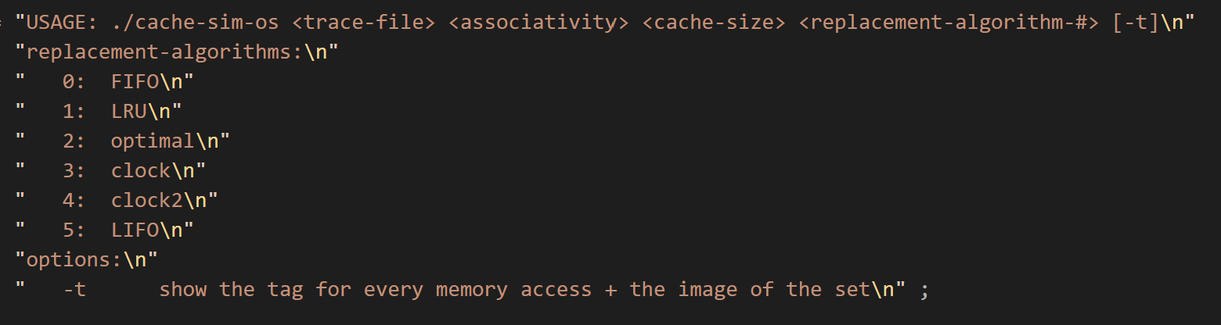
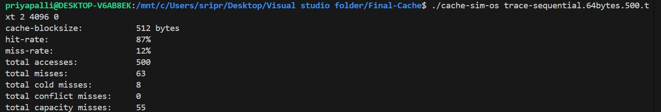
DEMO TIME
Notes:
Show results and debug feature on Visual Studio

Slide 15
Challenges
Initially planned to implement Clock-Pro, but replaced with 2-bit Clock algorithm due to time and complexity constraints
Focused primarily on read operations; write operations were not implemented due to time limitations
Faced difficulty implementing Clock algorithms because of limited prior knowledge
Struggled to fully understand the different types of cache misses and had to conduct additional research
Took time to figure out how to organize and map out simulation results clearly across different configurations and policies

Slide 16
What I learned
Gained a deeper understanding of cache memory and how replacement policies affect performance
Learned to manage time and scope effectively while balancing other heavy coursework
Discovered and implemented new cache algorithms, including Clock and Optimal (Belady’s)
Improved debugging and technical skills through hands-on coding and testing
Learned the importance of asking for help and seeking guidance when facing technical challenges
Enhanced overall knowledge and practical experience in Computer Architecture concepts

Slide 17
Conclusion
Gained a deeper understanding of cache behavior and simulator design
Key observations:
Higher associativity → higher hit rate
LRU > FIFO, and Optimal had the best performance
2-bit Clock outperformed 1-bit Clock; LIFO underperformed
Direct-mapped caches produced consistent results across policies
Sequential traces had stable results across policies but varied with cache size
Majority of misses were capacity misses
Successfully achieved high hit rates across various configurations
Applied and expanded on prior knowledge from undergraduate coursework
Reinforced how memory access patterns impact cache effectiveness
Future Work:
Add write operations and explore more replacement policies (e.g., Clock-Pro, MRU)
Use more diverse trace files for deeper analysis
Implement multi-level cache hierarchy
Extend simulator to Virtual Memory systems and page replacement policies
Explore further research opportunities in Computer Architecture

Slide 18
Thank you!

